Slide 1
Fuzzy Match for Question Answering Passage Retrieval
Hang Cui
Host: Jimmy Lin
cuihang@comp.nus.edu.sg
http://www.comp.nus.edu.sg/~cuihang

Slide 2
Introduction
Question answering (QA) demands precise answers, however
  We need fuzzy match to find correct answers
  Variations in natural language
Two fuzzy match schemes –
  Fuzzy match in lexico-syntactic patterns
    Definition sentence retrieval for definitional QA
  Fuzzy match of relationship between words
    Factoid QA passage retrieval
Notes:
Fuzzy match is also referred as soft match, statistical match

Slide 3
Outline
Generic soft pattern models for definitional QA
Fuzzy match of dependency relations for factoid QA
Conclusion

Slide 4
Outline
Generic soft pattern models for definitional QA
Fuzzy match of dependency relations for factoid QA
Conclusion

Slide 5
Patterns Are Everywhere
Information Extraction (IE)
noun preposition <noun_phrase>
e.g. bomb against <target>
Lexico-syntactic
Patterns
Question Answering (QA)
<search_term> , DT$ NNP ,
e.g. Gunter Blobel , a biologist
at … , said …
Other tasks
<subj> passive-verb
e.g. <subj> was satisfied

Slide 6
Two Methods of Pattern Matching
Hard Matching
  Rule induction
  Generalizing training instances into regular expression represented rules
  Performing slot by slot matching
Soft Matching
  e.g. Hidden Markov Models (HMM) in information extraction, but usually task-specific
  Generic soft pattern models
Notes:
Transitions about talking about the two methods in details in the next slides

Slide 7
Hard Matching
<PersonIN> , NNP , BE$ named to <POST>
Bob Lloyd , president and chief operating officer , was named to the chief executive.
Lee Abraham , 65 years old , former chairman and chief executive officer of Associated Merchandising Corp. , New York , was named to the board of the footwear manufacturer.
Gaps by insertion
Lack of flexibility in matching
  Can’t deal with gaps between rules and test instances
Notes:
Gaps can also be caused by deletion

Slide 8
Soft Matching
…… The channel Iqra is owned by the …
…… severance packages, known as golden parachutes, included ……
A battery is a cell which can provide electricity.
Training
DT$ NN <Search_Term> BE$ owned by
known as <Search_Term> , VB
<Search_Term> BE$ DT$
…… <Slot₋₂> <Slot₋₁> <Search_Term> <Slot₁> <Slot₂> ……
NN 0.12 NN 0.11 , 0.40 DT$ 0.2
known 0.09 as 0.20 BE$ 0.2 VB 0.1
DT$ 0.04 owned 0.09
Testing
… is known as Wicca, a neo-pagan nature religion, includes the use of herbal magic and witchcraft in its practice.
known as <Search_Term> , DT$
P ( Ins ) = P(“known”|S₋₂) + P(“as”|S₋₁) + P(“,”|S₁) + P(“DT$”|S₂)
+ P(“known as”) + P(“, DT$”)

Slide 9
We propose
Two generic soft pattern models
  Bigram model
  Profile Hidden Markov Model (PHMM)
    More complex model that handles gaps better
Evaluations on definitional question answering
  Can be applied to other pattern matching applications

Slide 10
Outline – Soft Patterns
Overview of Definitional QA
Bigram Soft Pattern Model
PHMM Soft Pattern Model
Evaluations

Slide 11
Outline – Soft Patterns
Overview of Definitional QA
Bigram Soft Pattern Model
PHMM Soft Pattern Model
Evaluations

Slide 12
Definitional QA
To answer questions like “Who is Gunter Blobel” or “What is Wicca”.
Why evaluating on definition sentence retrieval?
  Diverse patterns
  Definitional QA is one of the least explored areas in QA
(1) … that Wicca _ whose practitioners call themselves witches and believe in the dual deity of god and goddess _ is not a religion and should not be practiced on military bases.
(2) … , Wicca, as contemporary witchcraft is often called, has been growing in the United States and abroad.
(3) The Wiccans, whose religion is a reconstruction of nature worship from tribal Europe and other parts of the world, had to meet the same criteria as other religions to conduct services on the base, including sponsorship by a legally incorporated church, in this case one in San Antonio.
(4) Wicca adherents celebrate eight major sabbats, festivals that mark the change of seasons and agricultural cycles, and believe in both god and goddess.

Slide 13
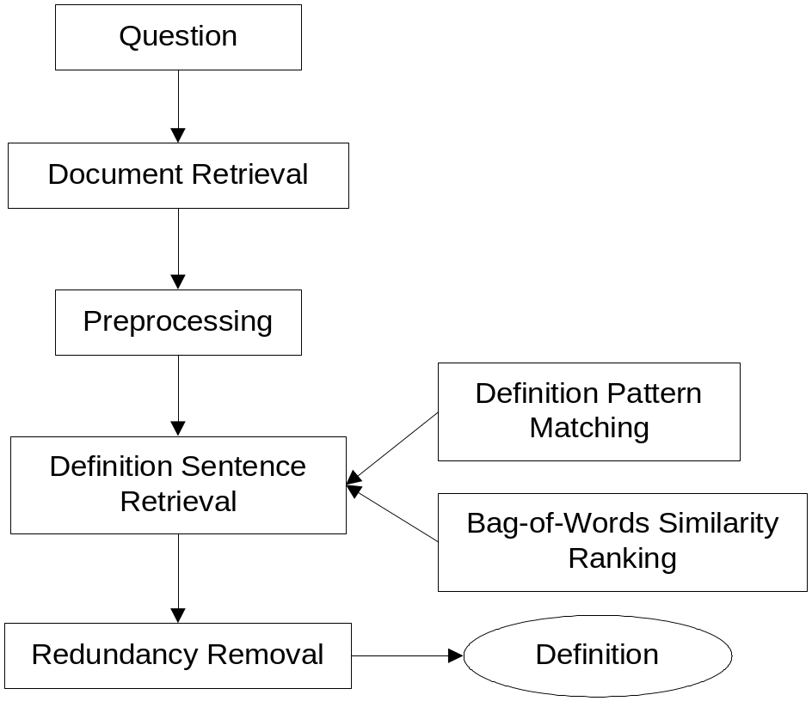
Pattern Matching for Definitional QA
Manually constructed patterns
  Appositive
    e.g. Gunter Blobel , a cellular and molecular biologist,…
  Copulas
    e.g. Battery is a kind of electronic device …
  Predicates (relations)
    e.g. TB is usually caused by …

Slide 14
Outline – Soft Patterns
Overview of Definitional QA
Bigram Soft Pattern Model
PHMM Soft Pattern Model
Evaluations

Slide 15
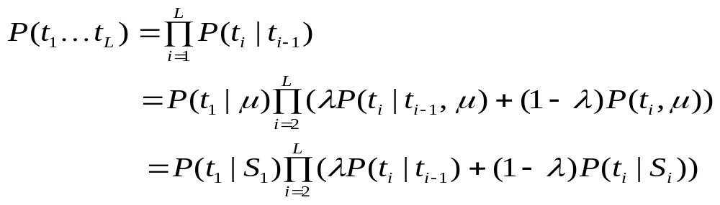
Bigram Soft Pattern Model
Bigram prob
Slot-aware unigram prob
P ( Ins ) = P(“known”|S₋₂) + P(“as”|S₋₁) + P(“,”|S₁) + P(“DT$”|S₂) + P(“known as”) + P(“, DT$”)
To estimate the interpolation mixture weight λ
  Expectation Maximization (EM) algorithm
Count words and general tags separately
  Avoid overwhelming frequency count of general tags
Notes:
Here we consider the pattern matching problem as a token sequence generation problem. So, we take the token sequence t1 till tL from the test instance and calculate its probability according to the training data. In a typical bigram model, this generation prob is multiplication of bigram probs. Here, we use linear interpolation to smooth the bigram probs and introduce two terms….

Slide 16
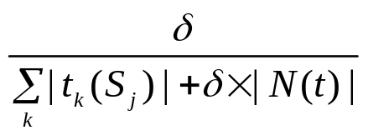
Bigram Model in Dealing with Gaps
Bigram model can deal with gaps
  Unseen tokens have small smoothing probabilities in specific positions
Pattern
<Search_Term> which is known for DT$ NNP
Test sentence:
<Search_Term> , whose book is known for
P(“,”|S₁) = P(“whose”|S₂) … = small smoothing prob
P(“known”|S₃) = 0.3 P(“for”|S₄) = 0.21
P(“,”|S₁) = P(“whose”|S₂) = P(“book”|S₃) = P(“is”|S₄) =
Not too good!

Slide 17
Outline – Soft Patterns
Overview of Definitional QA
Bigram Soft Pattern Model
PHMM Soft Pattern Model
Evaluations

Slide 18
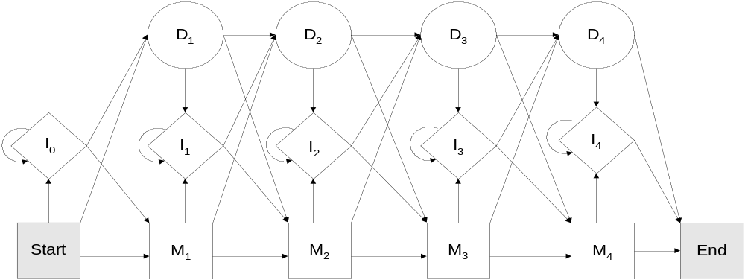
PHMM Soft Pattern Model
Better solution for dealing with gaps
Left to right Hidden Markov Model with insertion and deletion states

Slide 19
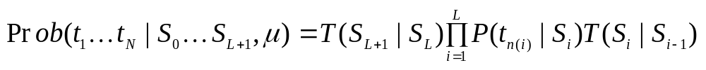
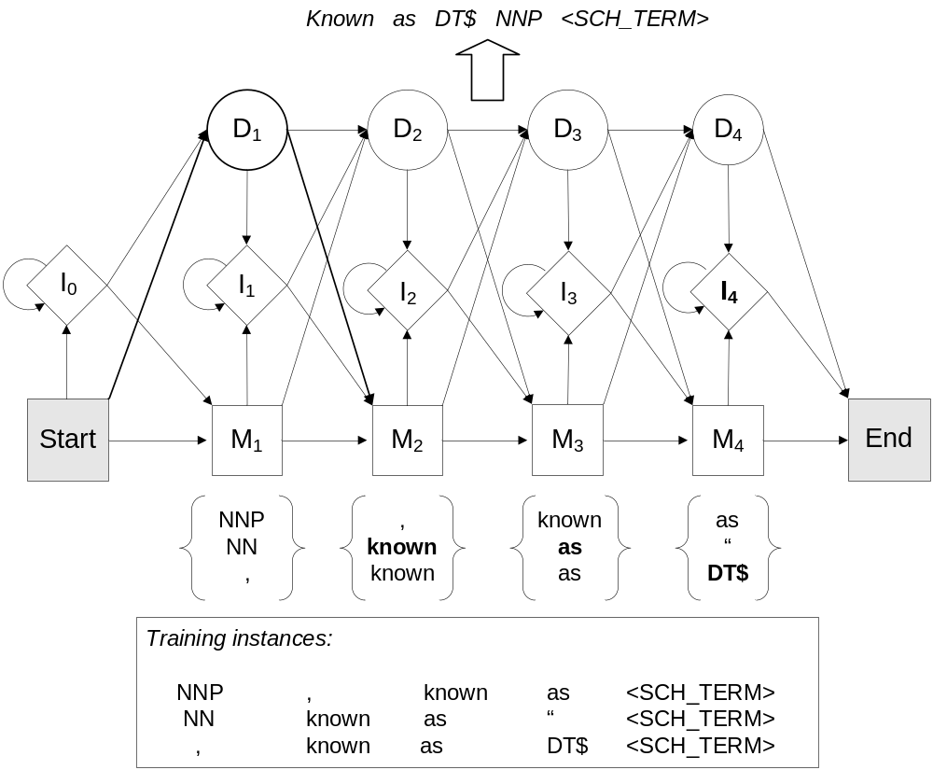
How PHMM Deals with Gaps
Calculating generative probability given a test instance
  Find the most probable path by Viterbi algorithm
  Efficient calculation by forward-backward algorithm
  Estimated by Baum-Welch algorithm
NNP
known
as
DT$

Slide 20
Outline – Soft Patterns
Overview of Definitional QA
Bigram Soft Pattern Model
PHMM Soft Pattern Model
Evaluations
  Overall performance evaluation
  Sensitivity to model length
  Sensitivity to size of training data

Slide 21
Evaluation Setup
Data set
  Test data: TREC-13 question answering task data
    AQUAINT corpus and 64 definition questions with answers
  Training data
    761 manually labeled definition sentences from TREC-12 question answering task data
Comparison systems
  Manually constructed patterns
    Most comprehensive to our knowledge

Slide 22
Evaluation Metrics
Manually checked F₃ measure
  Based on essential/acceptable answer nuggets
    NR – proportion of returned essential answer nuggets
    NP – penalty to longer answers
    Weighting NR 3 times as NP
  Subject to inconsistent scoring among assessors
Automatic ROUGE score
  Gold standard: sentences containing answer nuggets
  Counting the trigrams shared in the gold standard and system answers
  ROUGE-3-ALL (R3A) and ROUGE-3-ESSENTIAL (R3E)

Slide 23
Performance Evaluation
Soft pattern matching outperforms hard matching
Manual F3 scores correlate well with automatic R3 scores
 | HP | Bigram SP | PHMM SP
R3A | 0.2106 | 0.2303 (+9.37%) | 0.2234 (+6.08%)
R3E | 0.2286 | 0.2553 (+11.67%)* | 0.2496 (+9.18%)
F₃ | 0.4633 | 0.5088 (+9.83%)** | 0.4971 (+7.30%)**

Slide 24
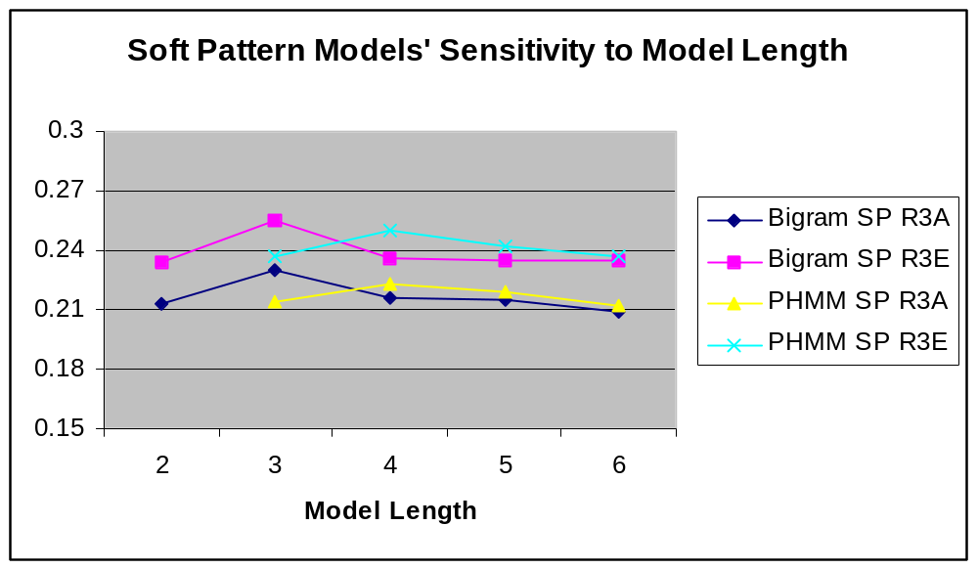
Sensitivity to Model Length
PHMM is less sensitive to model length
PHMM may handle longer sequences

Slide 25
Sensitivity to the Amount of Training Data
PHMM requires more training data to improve
 | Training Data size (fraction of whole training corpus)
 | 1/3 | 1/2 | 1
PHMM R3A | 0.2110 | 0.2179 (+3.24%) | 0.2234 (+5.85%)
PHMM R3E | 0.2311 | 0.2402 (+3.93%) | 0.2496 (+8.00%)
Bigram R3A | 0.2229 | 0.2269 (+1.76%) | 0.2303 (+3.32%)
Bigram R3E | 0.2478 | 0.2510 (+1.29%) | 0.2553 (+3.03%)
7.22%
2.28%

Slide 26
Discussions on Both Models
Capture the same information
  The importance of a token’s position in the context of the search term
  The sequential order of tokens
Different in complexity
  Bigram model
    Simplified Markov model with each token as a state
    Captures token sequential information by bigram probabilities
  PHMM model
    More complex – aggregated token sequential information by hidden state transition probabilities
Experimental results show
  PHMM is less sensitive to model length
  PHMM may benefit more by using more training data

Slide 27
Outline
Generic soft pattern models for definitional QA
Fuzzy match of dependency relations for factoid QA
Conclusion

Slide 28
Passage Retrieval in Question Answering
QA System
Document
Retrieval
To narrow down the search scope
Can answer questions with more context
Passage
Retrieval
Lexical density based
  Distance between question words
Answer
Extraction

Slide 29
Density Based Passage Retrieval Method
However, density based can err when …
<Question> What percent of the nation's cheese does Wisconsin produce?
Incorrect: … the number of consumers who mention California when asked about cheese has risen by 14 percent, while the number specifying Wisconsin has dropped 16 percent.
Incorrect: The wry “It's the Cheese” ads, which attribute California's allure to its cheese _ and indulge in an occasional dig at the Wisconsin stuff'' … sales of cheese in California grew three times as fast as sales in the nation as a whole 3.7 percent compared to 1.2 percent, …
Incorrect: Awareness of the Real California Cheese logo, which appears on about 95 percent of California cheeses, has also made strides.
Correct: In Wisconsin, where farmers produce roughly 28 percent of the nation's cheese, the outrage is palpable.
Relationships between matched words differ …

Slide 30
Our Solution
Examine the relationship between words
  Dependency relations
Exact match of relations for answer extraction
    Has low recall because same relations are often phrased differently
Fuzzy match of dependency relationship
  Statistical similarity of relations

Slide 31
Measuring Sentence Similarity
Sim (Sent1, Sent2) = ?
Sentence 1
Sentence 2
Matched words
Lexical matching
+
Similarity of relations
between matched words
Similarity of individual
relations
Notes:
Point out sent1 and sent2 are just for illustration of a generic scenario. In QA, they should be question and candidate sentence.

Slide 32
Outline – Fuzzy Dependency Relation Matching
Extracting and Paring Relation Paths
Measuring Path Match Scores
Learning Relation Mapping Scores
Evaluations

Slide 33
Outline – Fuzzy Dependency Relation Matching
Extracting and Paring Relation Paths
Measuring Path Match Scores
Learning Relation Mapping Scores
Evaluations

Slide 34
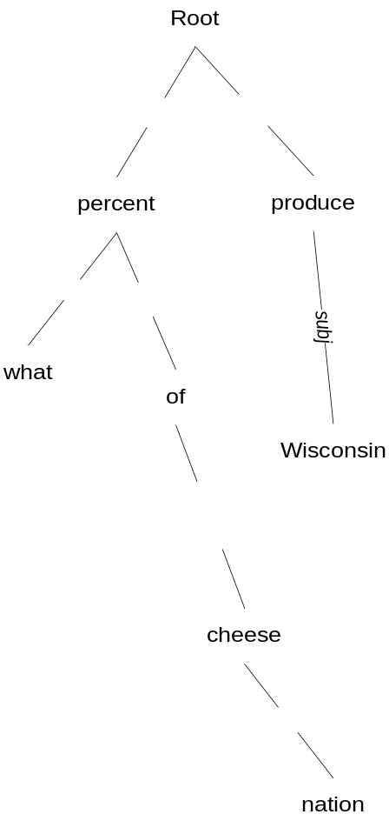
What Dependency Parsing is Like
Minipar (Lin, 1998) for dependency parsing
Dependency tree
  Nodes: words/chunks in the sentence
  Edges (ignoring the direction): labeled by relation types
What percent of the nation's cheese does Wisconsin produce?
Notes:
Explain no direction

Slide 35
Extracting Relation Paths
Relation path
  Vector of relations between two nodes in the tree
produce < P₁: subj > Wisconsin
percent < P₂: prep pcomp-n > cheese
Two constraints for relation paths:
Path length (less than 7 relations)
Ignore those between two words that
are within a chunk, e.g. New York.
Notes:
Explain chunk

Slide 36
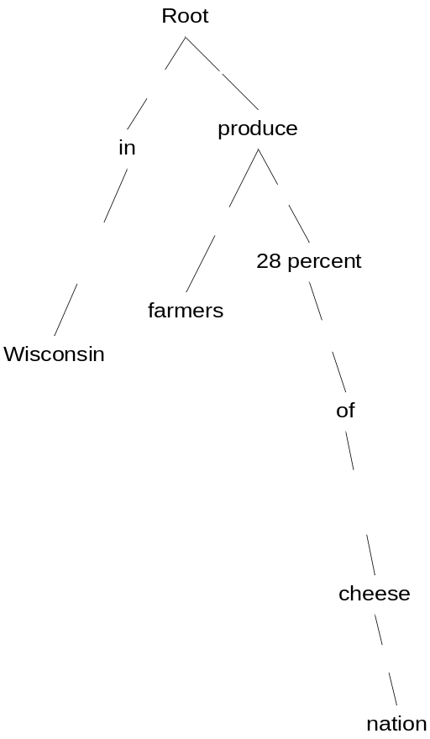
Paired Paths from Question and Answer
What percent of the nation's cheese does Wisconsin produce?
In Wisconsin, where farmers produce roughly 28 percent of the nation's cheese, the outrage is palpable.
< P₁^{(Q)} : subj >
< P₁^{(Sent)} : pcomp-n mod i >
Paired Relation Paths
Sim_{Rel} (Q, Sent) = ∑_{i,j} Sim (P_{i} ^{(Q)}, P_{j}^{(Sent)})
Notes:
Note: here is only one example of paired paths. We actually extract all corresponding paths between all matched question terms.

Slide 37
Outline – Fuzzy Dependency Relation Matching
Extracting and Paring Relation Paths
Measuring Path Match Scores
Learning Relation Mapping Scores
Evaluations

Slide 38
Measuring Path Match Degree
Employ a variation of IBM Translation Model 1
  Path match degree (similarity) as translation probability
    MatchScore (P_{Q}, P_{S}) → Prob (P_{S} | P_{Q} )
    Relations as words
Why IBM Model 1?
  No “word order” – bag of undirected relations
  No need to estimate “target sentence length”
    Relation paths are determined by the parsing tree
Notes:
Similarity ➔ asymmetric ➔ match degree

Slide 39
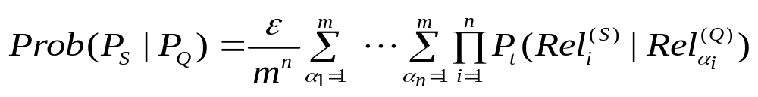
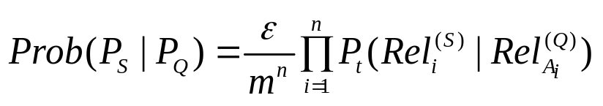
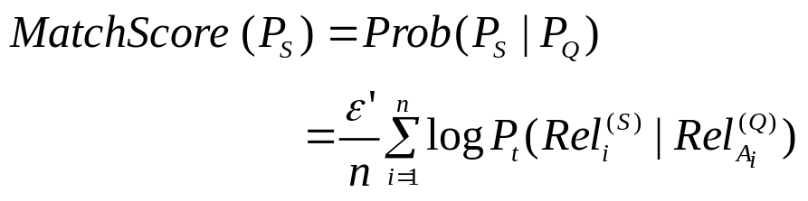
Calculating Translation Probability (Similarity) of Paths
Given two relation paths from the question and a candidate sentence
Considering the most probable alignment (finding
the most probable mapped relations)
Take logarithm and ignore the constants (for all
sentences, question path length is a constant)
MatchScores of paths are
combined to give the sentence’s
relevance to the question.
?

Slide 40
Outline – Fuzzy Dependency Relation Matching
Extracting and Paring Relation Paths
Measuring Path Match Scores
Learning Relation Mapping Scores
Evaluations

Slide 41
Training and Testing
Testing
Training
Sim ( Q, Sent ) = ?
Mutual information (MI) based
Expectation Maximization (EM) based
Q - A pairs
Similarity between relation vectors
Prob ( P_{Sent} | P_{Q} ) = ?
Paired Relation Paths
Similarity between individual relations
P ( Rel ^{(Sent)} | Rel ^{(Q)} ) = ?
Relation
Mapping
Scores
Relation Mapping Model

Slide 42
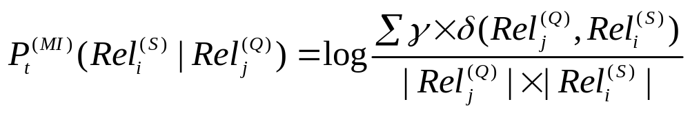
Approach 1: MI Based
Measures bipartite co-occurrences in training path pairs
  Accounts for path length (penalize those long paths)
  Uses frequencies to approximate mutual information
Notes:
Address about “counting”

Slide 43
Approach 2: EM Based
Employ the training method from IBM Model 1
  Relation mapping scores = word translation probability
  Utilize GIZA to accomplish training
  Iteratively boosting the precision of relation translation probability
Initialization – assign 1 to identical relations and a small constant otherwise

Slide 44
Outline – Fuzzy Dependency Relation Matching
Extracting and Paring Relation Paths
Measuring Path Match Scores
Learning Relation Mapping Scores
Evaluations
  Can relation matching help?
  Can fuzzy match perform better than exact match?
  Can long questions benefit more?

Slide 45
Evaluation Setup
Training data
  3k corresponding path pairs from 10k QA pairs (TREC-8, 9)
Test data
  324 factoid questions from TREC-12 QA task
Passage retrieval on top 200 relevant documents by TREC

Slide 46
Comparison Systems
MITRE –baseline
  Stemmed word overlapping
  Baseline in previous work on passage retrieval evaluation
SiteQ – top performing density based method
  using 3 sentence window
NUS
  Similar to SiteQ, but using sentences as passages
Strict Matching of Relations
  Simulate strict matching in previous work for answer selection
  Counting the number of exactly matched paths
Relation matching are applied on top of MITRE and NUS

Slide 47
Evaluation Metrics
Mean reciprocal rank (MRR)
  Measure the mean rank position of the correct answer in the returned rank list
  On the top 20 returned passages
Percentage of questions with incorrect answers
Precision at the top one passage

Slide 48
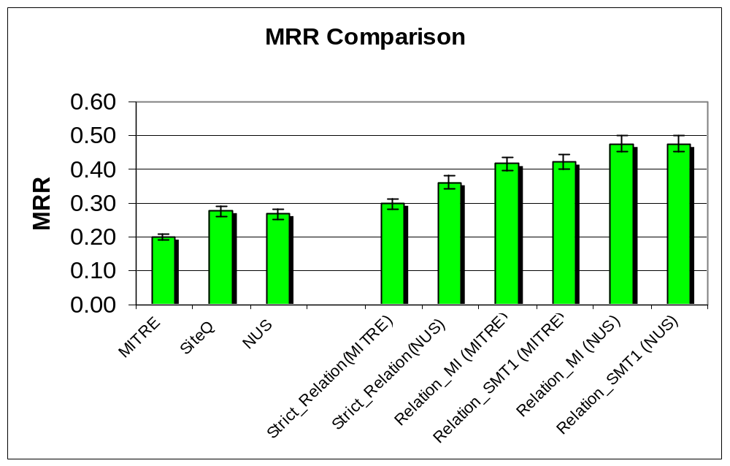
Performance Evaluation
All improvements are statistically significant (p<0.001)
MI and EM do not make much difference given our training data
  EM needs more training data
  MI is more susceptible to noise, so may not scale well
Fuzzy matching outperforms strict matching significantly.
Passage retrieval systems | MITRE | SiteQ | NUS | Rel_Strict (MITRE) | Rel_Strict (NUS) | Rel_MI (MITRE) | Rel_EM (MITRE) | Rel_MI (NUS) | Rel_EM (NUS)
MRR | 0.2000 | 0.2765 | 0.2677 | 0.2990 | 0.3625 | 0.4161 | 0.4218 | 0.4756 | 0.4761
% MRR improvement over MITRE SiteQ NUS | N/A N/A N/A | +38.26 N/A N/A | +33.88 N/A N/A | +49.50 +8.14 +11.69 | +81.25 +31.10 +35.41 | +108.09 +50.50 +55.43 | +110.94 +52.57 +57.56 | +137.85 +72.03 +77.66 | +138.08 +72.19 +77.83
% Incorrect | 45.68% | 37.65% | 33.02% | 41.96% | 32.41% | 29.63% | 29.32% | 24.69% | 24.07%
Precision at top one passage | 0.1235 | 0.1975 | 0.1759 | 0.2253 | 0.2716 | 0.3364 | 0.3457 | 0.3889 | 0.3889
Notes:
Table should be more clear?

Slide 49
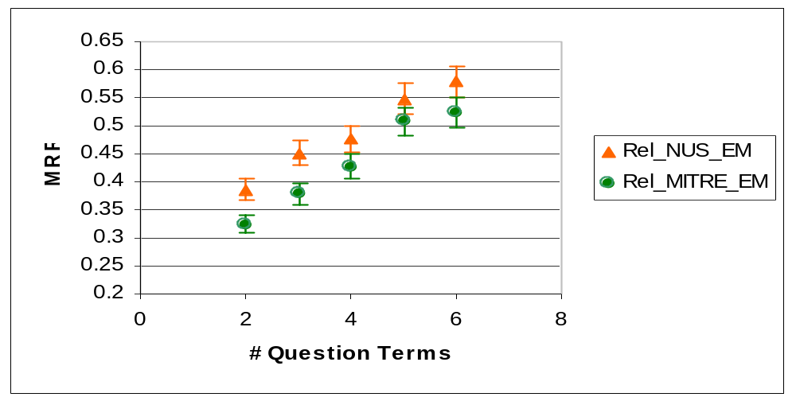
Performance Variation to Question Length
Long questions, with more paired paths, tend to improve more
  Using the number of non-trivial question terms to approximate question length

Slide 50
Error Analysis
Mismatch of question terms
    e.g. In which city is the River Seine
    Introduce question analysis
Paraphrasing between the question and the answer sentence
    e.g. write the book → be the author of the book
    Most of current techniques fail to handle it
    Finding paraphrasing via dependency parsing (Lin and Pantel)

Slide 51
Outline
Generic soft pattern models for definitional QA
Fuzzy match of dependency relations for factoid QA
Conclusion

Slide 52
Conclusion
Two schemes of fuzzy match for question answering
  Soft pattern models
  Fuzzy match of dependency relations between words
Next steps
  Definition sentence retrieval – clustering of predicates for those not matched by patterns
  Relax node match in dependency relation matching – linguistic knowledge

Slide 53
Q & A
Thanks!
☺

Slide 54
Performance on Top of Query Expansion
On top of query expansion, fuzzy relation matching brings a further 50% improvement
However
  query expansion doesn’t help much on a fuzzy relation matching system
  Expansion terms do not help in paring relation paths
Passage Retrieval Systems | NUS (baseline) | NUS+QE | Rel_MI (NUS+QE) | Rel_EM (NUS+QE)
MRR (% improvement over baseline) | 0.2677 | 0.3293 (+23.00%) | 0.4924 (+83.94%) | 0.4935 (+84.35%)
% MRR improvement over NUS+QE | N/A | N/A | +49.54% | +49.86%
% Incorrect | 33.02% | 28.40% | 22.22% | 22.22%
Precision at top one passage | 0.1759 | 0.2315 | 0.4074 | 0.4074
Rel_EM (NUS)
0.4761

